Slide 1
Serial Communication
Melvin C Jose

Slide 2
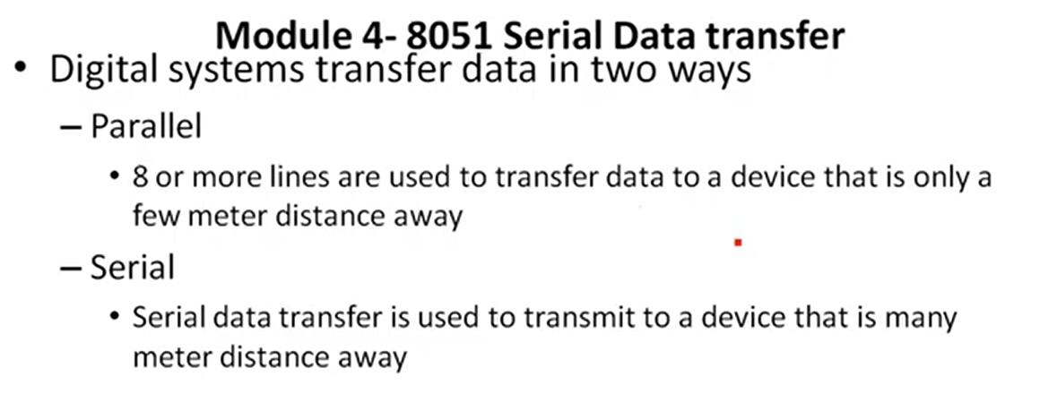
Serial Communication- Data transfer

Slide 3
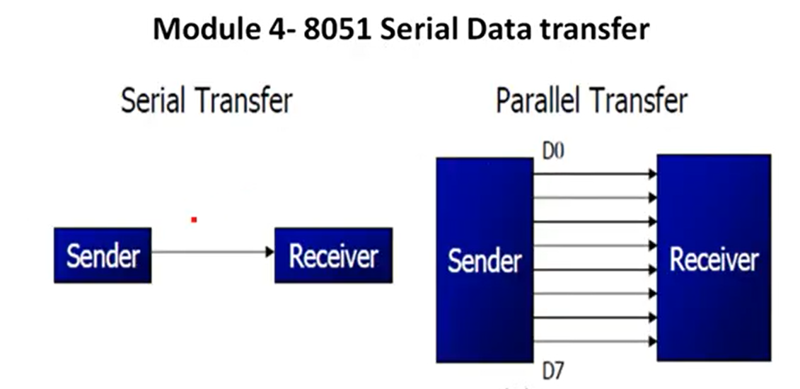
Serial Communication- Data transfer

Slide 4
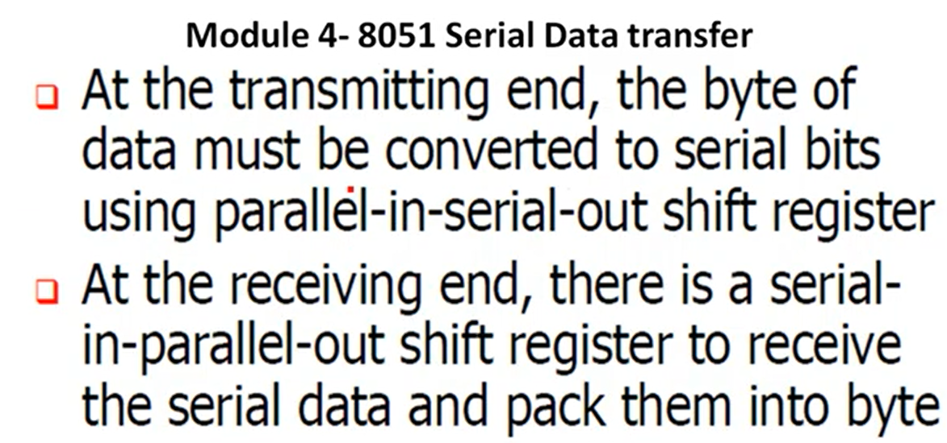
Serial Communication- Data transfer

Slide 5
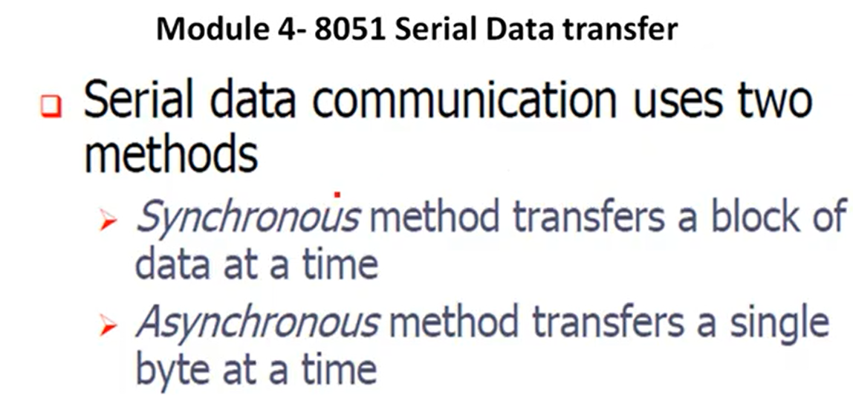
Serial Communication- Data transfer

Slide 6
Serial Communication- Data transfer
There are two types of transmission based on the channel utilization
Simplex
Data transmission is allowed only in one direction
Duplex
Data transmission is allowed in both ways
Further classified in to two
Half duplex
Full duplex

Slide 7
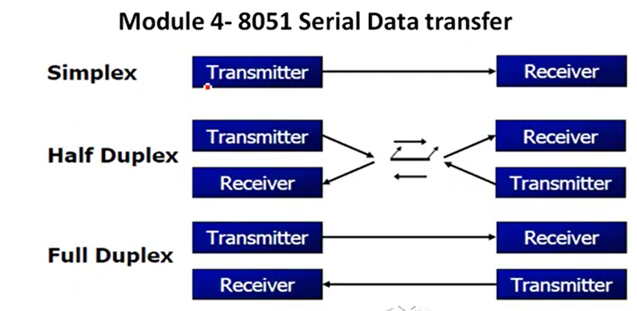
Serial Communication- Data transfer

Slide 8
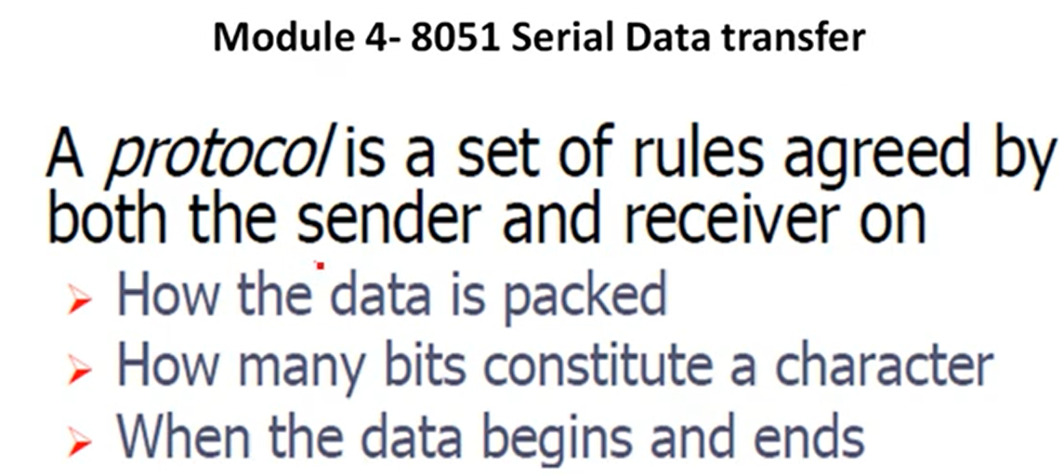
Serial Communication- Protocol in Data transfer

Slide 9
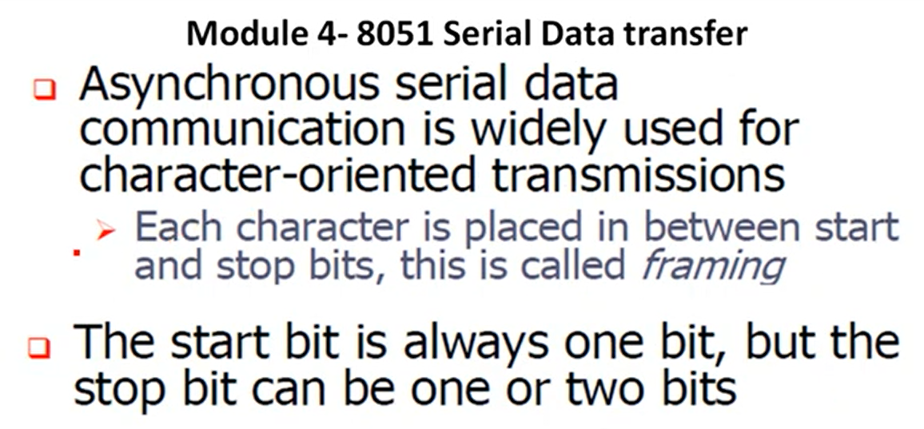
Serial Communication- Start bit and stop bit in Data transfer
Over head =if total frame contains 10 bit =then overhead = 2/8=1/4=25 %

Slide 10
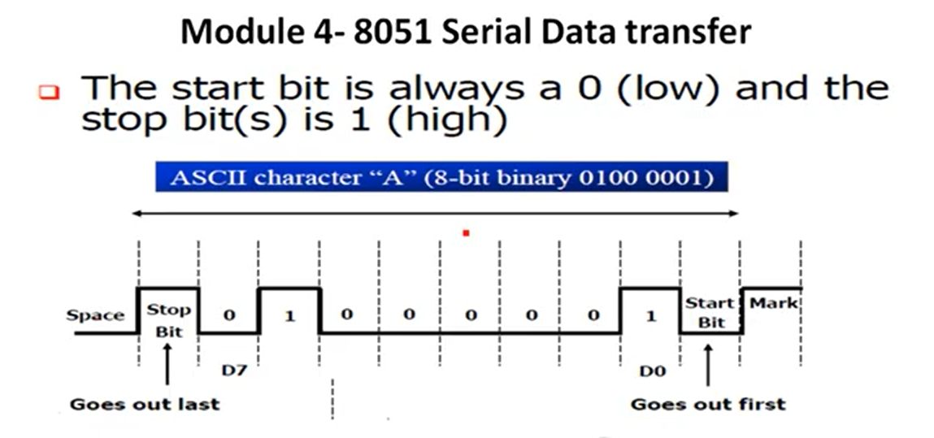
Serial Communication- Start bit and stop bit in Data transfer
If there is no communication Then mark signal is established(It is a continuous Logic 1 signal)
If stop bit is zero it reads as error(normally it is one)
Timer 1 is used here. SBUF is used here.

Slide 11
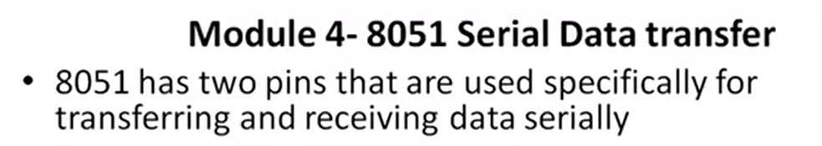
Serial Communication- Start bit and stop bit in Data transfer
These pins are TxD and RxD and are part of the port 3 pins (P3.0 and P3.1)
An interfacing standard is used between the transmitter and receiver known as RS232(MAX 232 IC is used in both sides)
In RS323 logic 1 is represented by -3 to -25V, while a 0 bit by +3 to +25 making -3 to +3 as undefined (Noise margin)
We need an voltage converter to convert RS 323 signals to TTL and vice versa so that the voltage levels will be accepted at 8051 side and RS 232 side

Slide 12
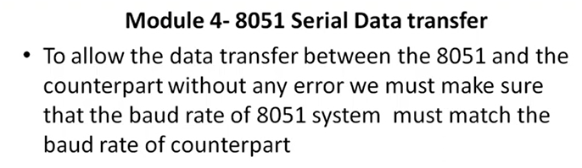
Serial Communication- Baud rate in Data transfer
Baud rate = Bits per second(Normally 9600 different standards are there)
The baud rate in the 8051 is programmable. This is done with the help of Timer 1(in mode 2). When used for serial port, the frequency of timer tick is determined by (XTAL/12)/32 and 1 bit is transmitted for each timer period

Slide 13
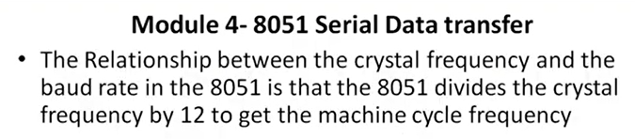
Serial Communication- Baud rate in Data transfer
If the oscillator is XTAL = 11.0592 MHz the machine cycle frequency is 921.6 KHz
8051’s UART divides the machine cycle frequency of 921.6 KHz by 32 once more before it is used by timer 1 to set the baud rate 921 KHz divided by 32 gives 28 800 Hz .
Timer 1 must be programmed in mode 2 , that is 8 bit auto reload mode
32 is programmable in PCON(D7=SMODE if it is one then 32 changes to 16)

Slide 14
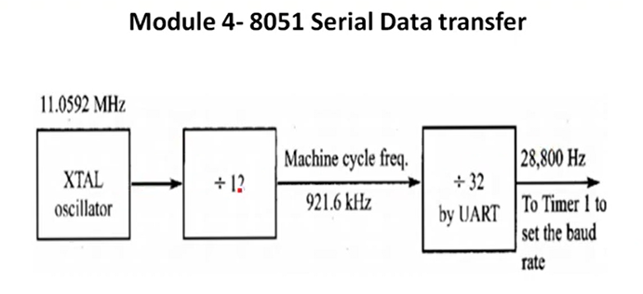
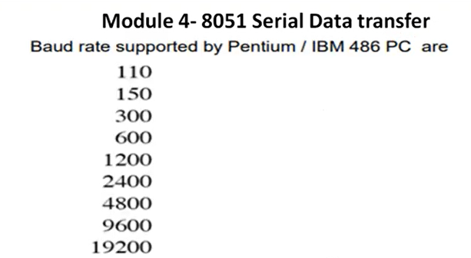
Serial Communication- Baud rate in Data transfer

Slide 15
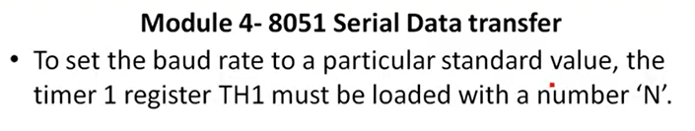
Serial Communication- Baud rate in Data transfer
Calculation of N
Clock frequency of timer clock: F=(11.0592 MHz/12)/32 = 28 800 Hz
Time period of each clck tick:T0 = 1/f = 1/28800
Duration of timer : N*T0 (N is the number of clock ticks)
1/baud rate = N*1/28800 if baud rate is 9600 then
N = F/Baud rate = 28800/9600 =3 (Timer TH1 should be loaded with FD for 3 counts that gives 9600 baud rate)

Slide 16
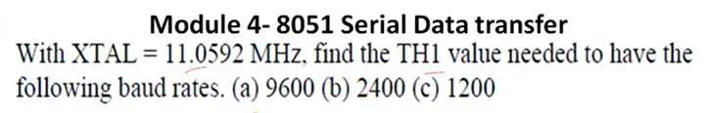
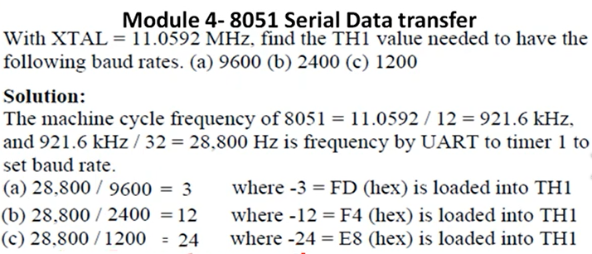
Serial Communication- Baud rate in Data transfer

Slide 17
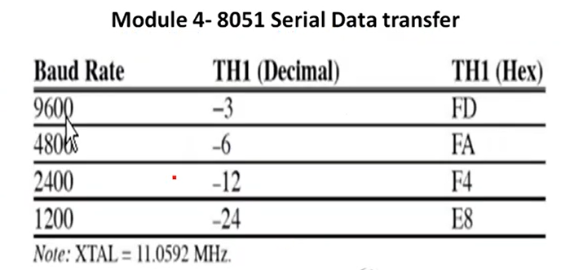
Serial Communication- Baud rate in Data transfer

Slide 18
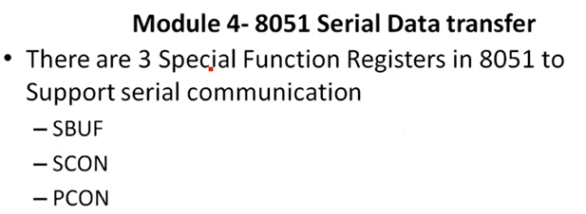
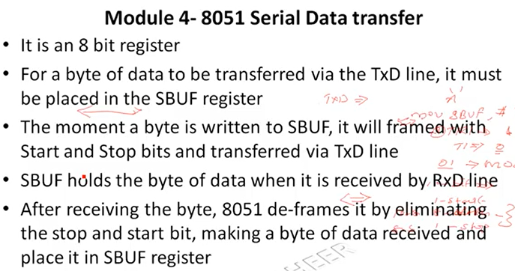
Serial Communication- Registers in Data transfer

Slide 19
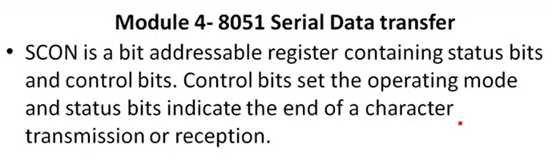
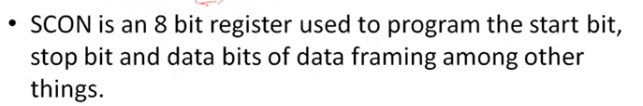
Serial Communication- Registers in Data transfer

Slide 20
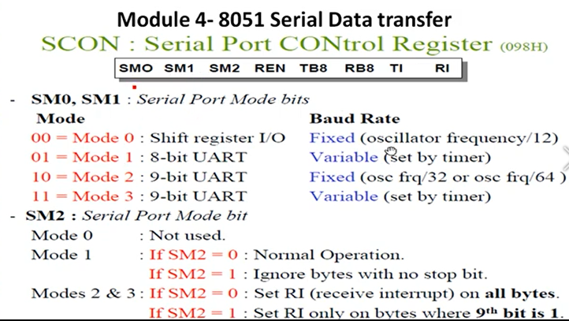
Serial Communication- Registers in Data transfer

Slide 21
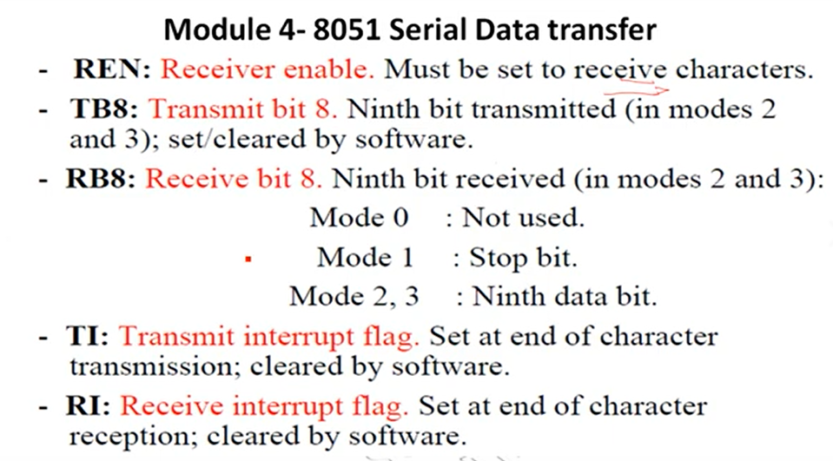
Serial Communication- Registers in Data transfer

Slide 22
Serial Communication- Transmission
In programming 8051 to transfer data serially
TMOD register should load with 20H to operate time1 in mode 2(8 bit auto reload ) to set the baud rate.
TH1 must load with a value to set the baud rate for serial transfer
SCON register should load with 50H, so that mode 1 operation with 8 bit data, one start bit (0) and a stop bit (1)
TR1 should set to 1 to start the timer
T1 should clear by CLR TI instruction
The character byte to be transfer should write in to SBUF register

Slide 23
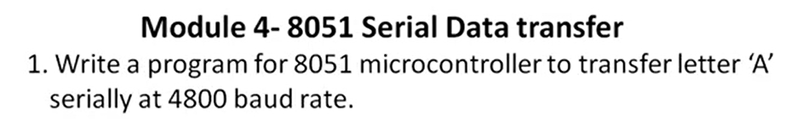
Serial Communication- Transmission
T1 flag bit is monitored continuously with the help of JNB TI,Here to check the character has been transferred completely
To transfer next byte repeat from step 5
MOV TMOD,#20H
MOV TH1,#-6
MOV SCON, # 50H
SETB TR1
Again: CLR TI
MOV SBUF, #’A’
Wait: JNB TI, Wait
SJMP Again

Slide 24
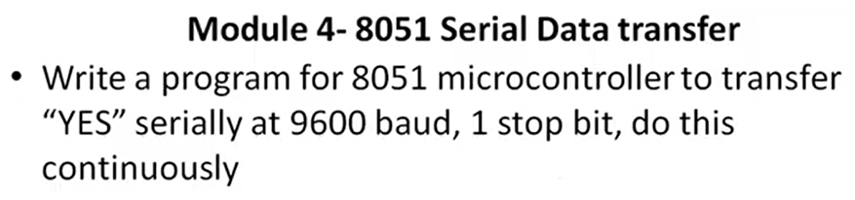
Serial Communication- Transmission
MOV TMOD, #20H
MOV TH1,#-3
MOV SCON, # 50H
SETB TR1
Repeat: MOV A,#’Y’
ACALL Transmit
MOV A,#’E’
ACALL Transmit
MOV A,#’s’
ACALL Transmit
Transmit: MOV SBUF,A
Wait: JNB TI, Wait
CLR TI
RET

Slide 25
Serial Communication- Reception
In programming 8051 to transfer data serially
TMOD register should load with 20H to operate time1 in mode 2(8 bit auto reload ) to set the baud rate.
TH1 must load with a value to set the baud rate for serial transfer
SCON register should load with 50H, so that mode 1 operation with 8 bit data, one start bit (0) and a stop bit (1)
TR1 should set to 1 to start the timer
R1 should clear by CLR RI instruction

Slide 26
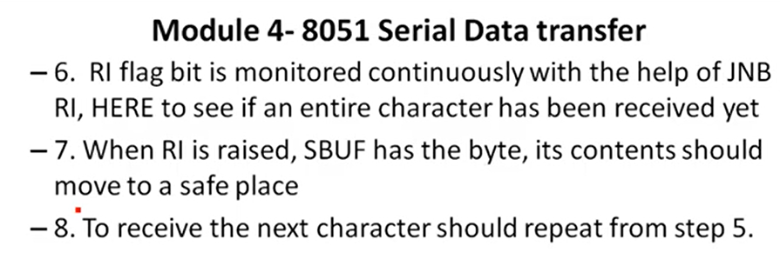
Serial Communication- Reception

Slide 27
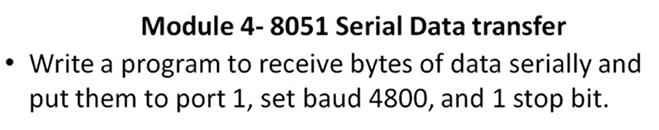
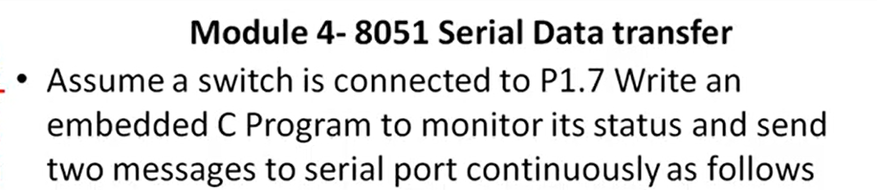
Serial Communication- Reception

Slide 28
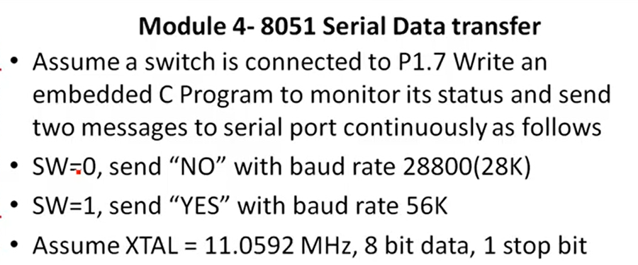
Serial Communication- Reception

Slide 29
Serial Communication- Reception
If (sw==0)
{
for(z=0;z<2;z++)
{
SBUF=mesg1[z];
while(TI==00) { , }
TI=0
}
}
Else
{
PCON=PCON |0x80;
for(z=0;z<3;z++)
{
SBUF=mesg2[z];
while(TI==00) { , }
TI=0
}
}
}
#include<reg51.h>
Sbit sw=p1^5;
Void main(void)
{
Unsigned char z;
Unsigned char mesg1[]=“No”;
Unsigned char mesg2[]=“yes”;
TMOD = 0x20;
TH1=0xff;
TR1=1;

